Slide 1

Cheaper Airport to Fly From: Des Moines vs. Kansas City
A data-driven approach to finding the most cost-effective airport for your travel needs.
Analysis by Neemias Moreira
Professor: Rob Poulton

Slide 2




The Challenge
Problem
Objective
Choosing between Des Moines and Kansas City airports is confusing. Price comparisons are time-consuming.
Use regression analysis to evaluate price differences. Determine which airport offers better value.
Impact
Make informed travel decisions based on statistical evidence. Save money on future flights.

Slide 3




Data Collection
Data Source
Amitzala's Kaggle dataset with historical flight fares from 1993-2024.
Data Filtering
Isolated DSM and MCI airport departures from 2023 only.
Original data set 245,955 observations, after filtering 143.
Variables Selected
Flight price, airport, distance, passengers, seasonality, and market share of the companies.

Slide 4

Data Preprocessing
Filtering Records
Selected only flights departing from DSM and MCI airports.
Variable Selection
Removed unnecessary columns. Kept only relevant predictors.
Creating Seasonality Variables
Generated quarter-based dummy variables to capture seasonal effects.
Multicollinearity Check
Verified independent variables weren't highly correlated with each other.

Slide 5
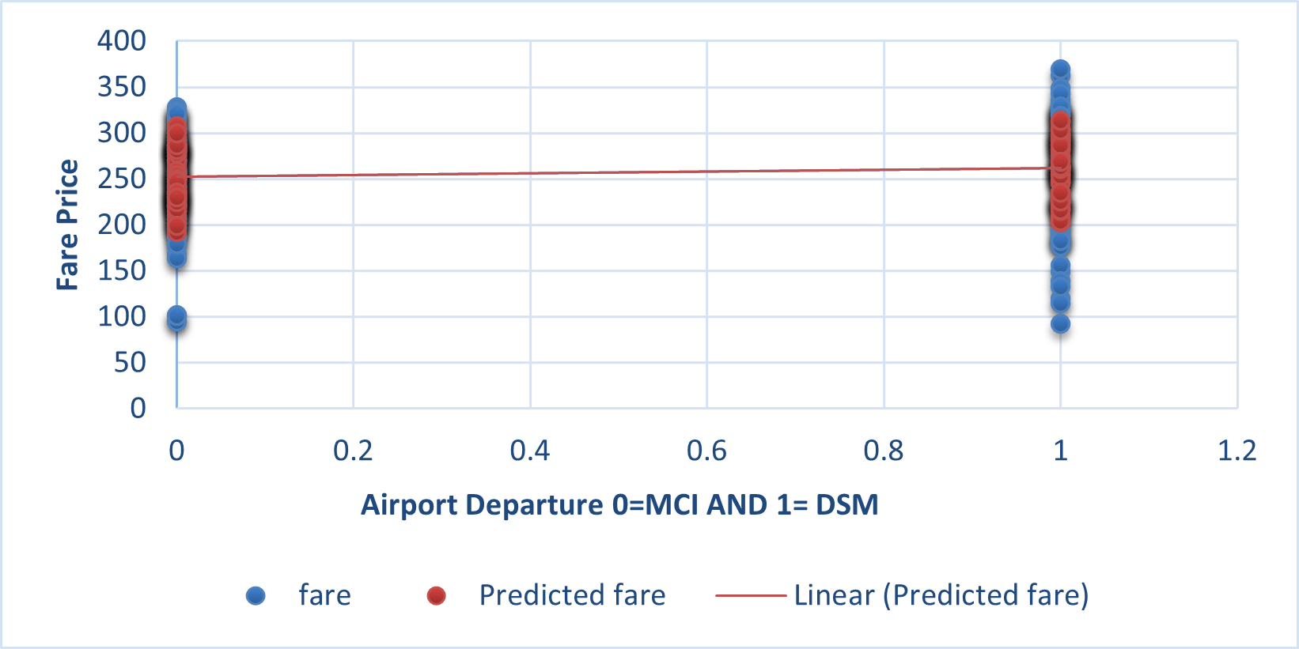
Hypothesis Testing
Null Hypothesis (H₀)
Alternative Hypothesis (H₁)
Testing Approach
No significant difference exists in average flight prices between Des Moines and Kansas City airports.
A significant difference exists in flight prices. One airport consistently offers cheaper flights.
Regression analysis with airport as a key independent variable. P-value threshold set at 0.05.

Slide 6
The Regression Model
Y = β₀ + β₁X₁ + β₂X₂ + β₃X₃ + β₄X₄ + β₅X₅ + β₆X₆ + β₇X₇
Key variables from the regression model, their coefficients, and statistical significance:
Variable
Coefficient
P-value
Significance
Intercept
335.43
1.92407E-15
Significant
Quarter 1
-11.69
0.349783193
Not significant
Quarter 2
2.05
0.86910634
Not significant
Quarter 3
-13.39
0.276241392
Not significant
Airport DSM
-11.21
0.271367646
Not significant
Distance (miles)
0.0259
0.256564602
Not significant
Passengers
-0.0824
0.000174134
Significant
Large market share
-125.77
2.96912E-07
Significant

Slide 7





Key Findings
Airport Impact
It might suggest that DSM flights are in average $11.21 cheaper than MCI.
Not statistically significant.
Seasonality Effect
Q1 and Q3 show slightly lower prices. Not statistically significant.
Passenger Volume
More passengers correlate with lower prices. Statistically significant factor.
Market Share Impact
Airlines with large market share offer significantly cheaper flights.

Slide 8





Conclusion
Key Insight
Airport choice has minimal impact on ticket price
Major Price Factors
Passenger volume and airline market share
Model Performance
3
Explains R Squared 0.259 (25.9%) of price variation
Significance F = 7.65716E-07, indicating the model is statistically significant.

Slide 9








Future Research Directions
Time Factors
Recent Data
Add days until departure and day-of-week variables
Include 2024 flight prices and post-pandemic trends
Route Analysis
More Variables
Compare specific destination routes from each airport
Analyze airline-specific strategies and fuel cost impacts
Other factors like fuel costs, promotions, and booking timing likely influence the remaining price variation.

Slide 10




References & Acknowledgments
Primary Dataset
Statistical Methods
Visualization Tools
Amitzala's historical flight fare dataset on Kaggle (1993-2024)
Regression analysis techniques from contemporary transportation economics literature
Data cleaned and filtered using R, model build in Excel Data Analysis toolkit.
QUESTIONS?

